Slide 1

Hospital Recommendation System
DSCI Project by:
112003108 – Vishal Patil
112003121 – Kshitij Salunke
112003128 – Shaikh Adnan

Slide 2
Flow of the Project
Data Extraction
Data Pre-processing
Data modelling

Slide 3


Data Extraction - Tools

Slide 4

Data Extraction
We used Selenium and Beautiful Soup for extracting data from google maps.
We stored all the data in a csv file

Slide 5
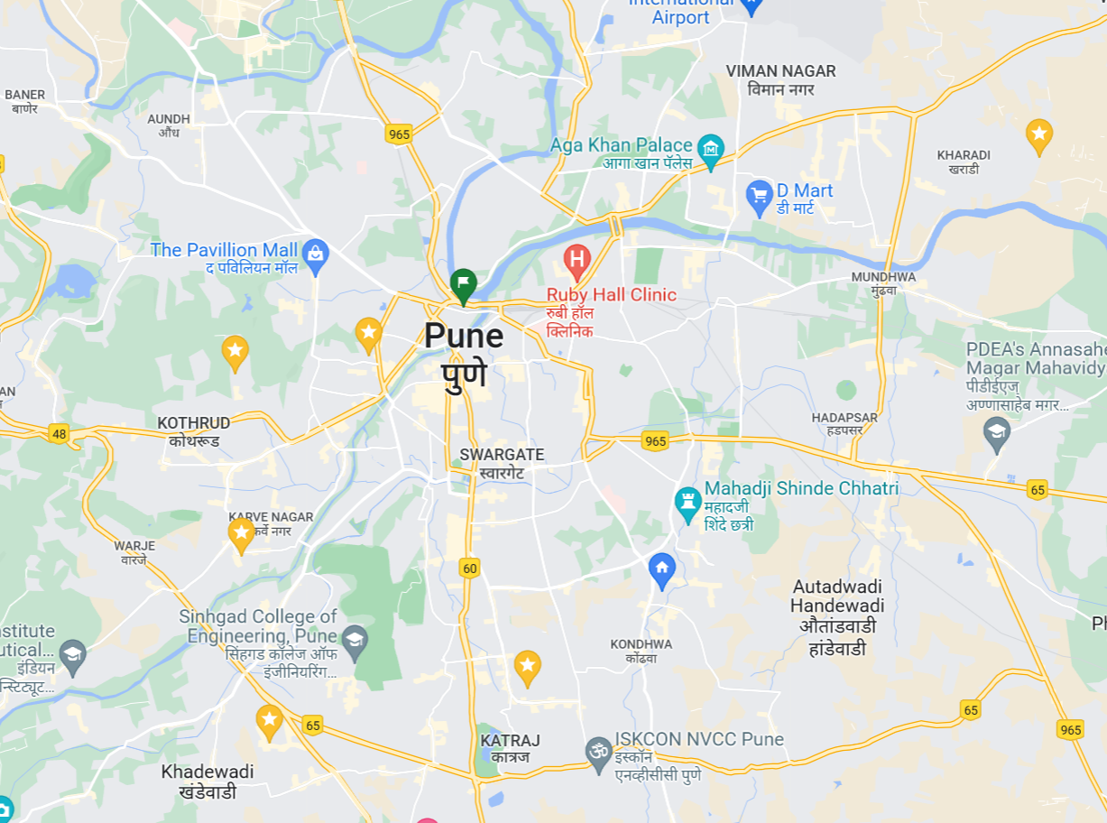

Slide 6


Data Pre-Processing Tools

Slide 7
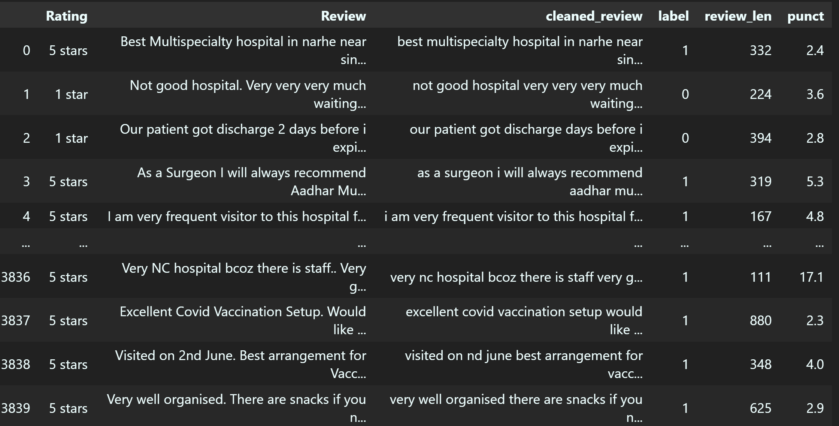
Data Preprocessing
Using pandas, collected all the data in a panda object.
Removed "Translated by Google" from the reviews (As some reviews were not in English)
Punctuations were removed

Slide 8
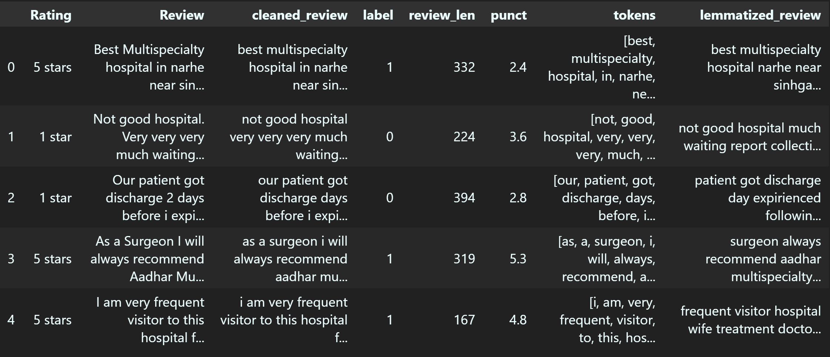
Data Preprocessing
We used lemmatization after tokenizing the reviews

Slide 9
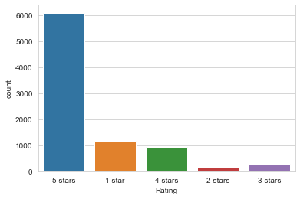
Graph

Slide 10
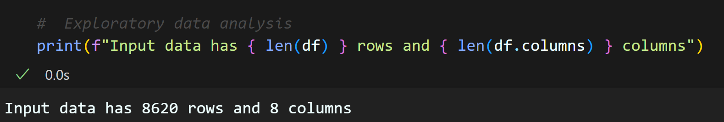
Exploratory Data Analysis

Slide 11
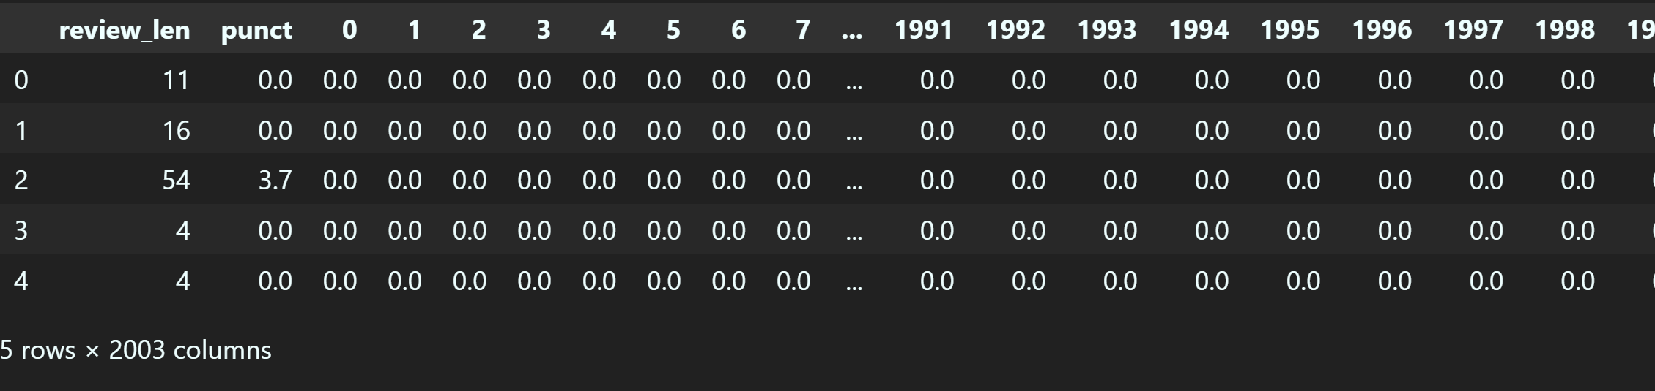
Making the data suitable for machine learning model
We used the TFID Vectorizer
Ignore terms that occur in more than 50% documents and the ones that occur in less than 2

Slide 12
Data Modelling
We used the sklearn library for training our data.
Utilized Multinomial NB, Logistic Regression, SVM, and KNN

Slide 13
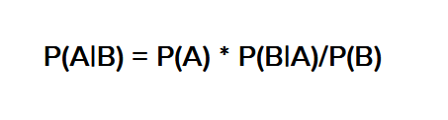
Multinomial Naïve Bayes
Probabilistic learning method
Based on the Bayes theorem
Calculates the probability of each tag for a given sample and then gives the tag with the highest probability as output.

Slide 14
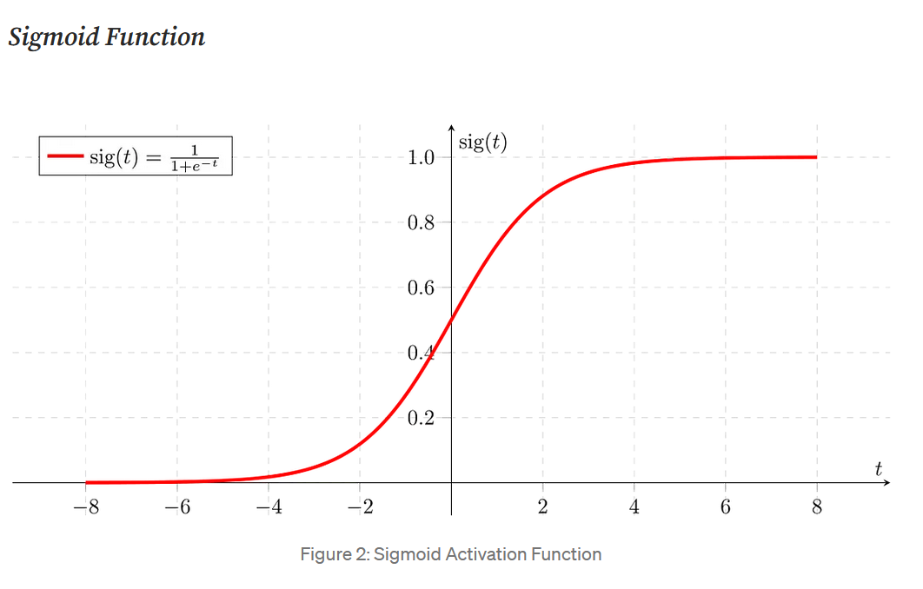
Logistic Regression
Used in categorical analysis

Slide 15
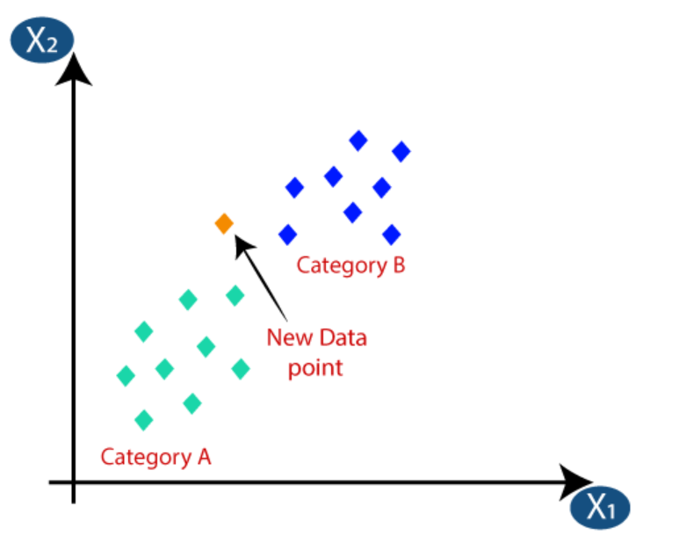
K-nearest neighbour
Assumes the similarity between the new case/data and available cases and put the new case into the category that is most similar to the available categories.
5/4 star
3/2/1 star

Slide 16
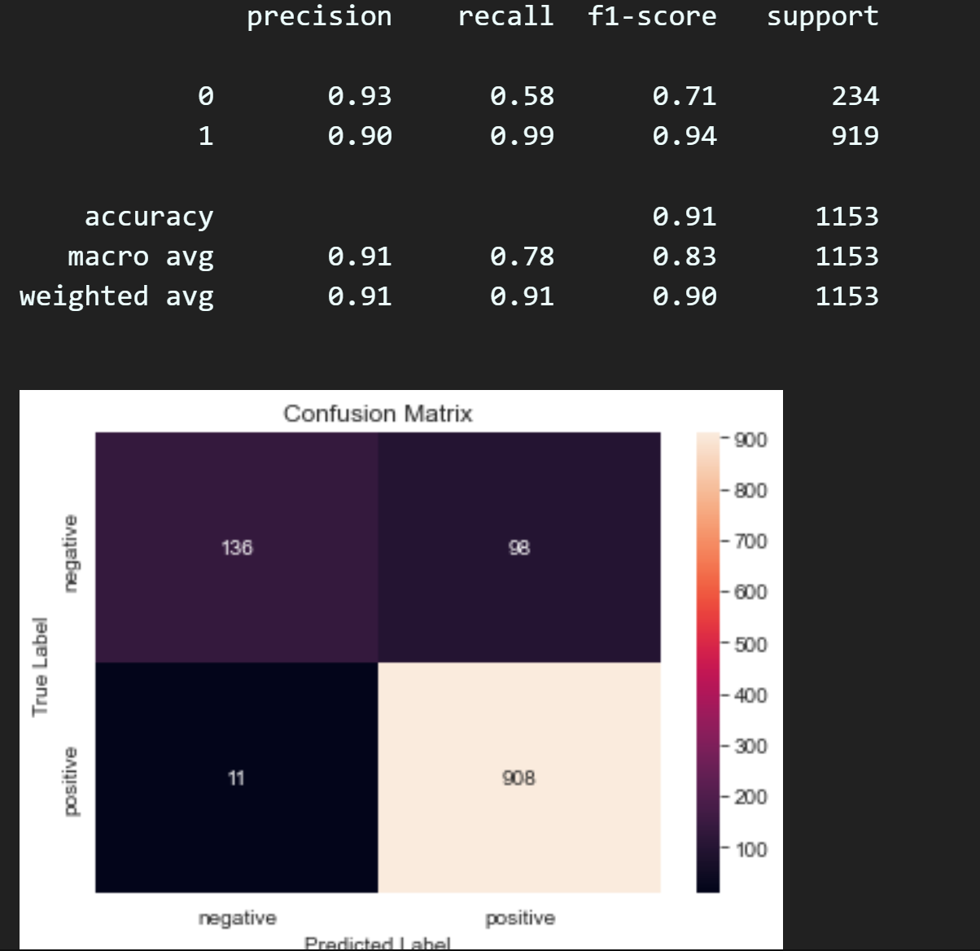
Confusion Matrix

Slide 17
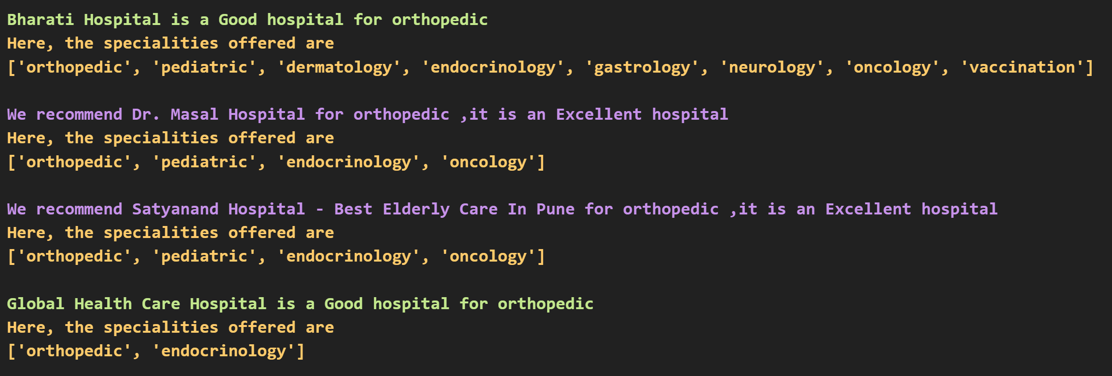
Recommendation

Slide 18

Hospitals near me
Based on user-provided latitude, longitude, range and specialist requirement, shows nearest hospitals.

Slide 19
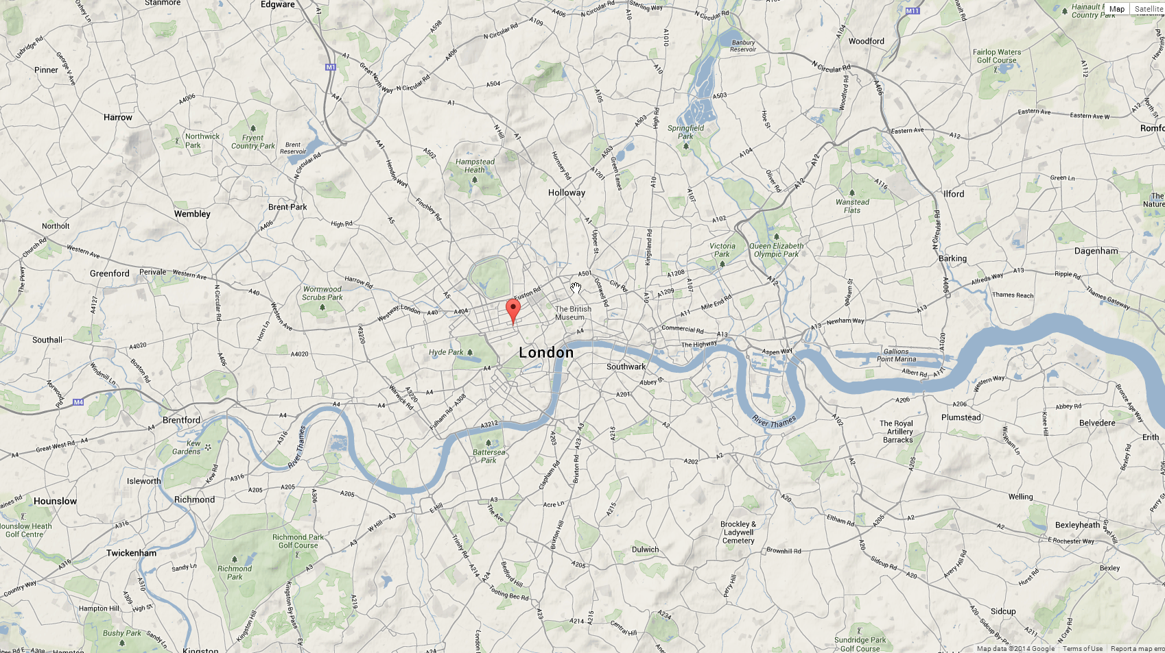
Thank You
This Photo by Unknown author is licensed under CC BY-SA.

